Slide 1
C - Structures
Dr. Sheak Rashed Haider Noori
Professor & Head(In-charge)
Dept. of Computer Science & Engineering

Slide 2
C - Structures
C arrays allow you to define type of variables that can hold several data items of the same kind but structure is another user defined data type available in C programming, which allows you to combine data items of different kinds.
Structure is the collection of variables of different types under a single name for better handling.
Structures are used to represent a record, Suppose you want to keep track of your books in a library. You might want to track the following attributes about each book:
Title
Author
Subject
Book ID

Slide 3
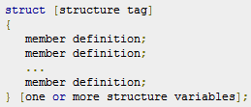
Defining a Structure
To define a structure, you must use the struct statement. The struct statement defines a new data type, with more than one member for your program.
The format of the struct statement is this:
The structure tag is optional and each member definition is a normal variable definition, such as int i; or float f; or any other valid variable definition.
At the end of the structure's definition, before the final semicolon, you can specify one or more structure variables but it is optional.

Slide 4
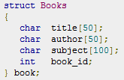

Defining a Structure
Here is the way you would declare the Book structure:
Example 1
Structure tag
Member definition
Example 2
structure variables
With the declaration of the structure you have created a new type, called Books.

Slide 5
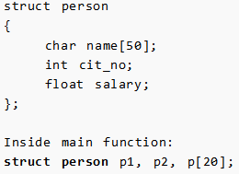
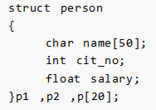
Structure variable declaration
When a structure is defined, it creates a user-defined type but, no storage is allocated.
For the above structure of person, variable can be declared as:
Another way of creating structure variable is:
In both cases, 2 variables p1, p2 and array p having 20 elements of type struct person are created.

Slide 6
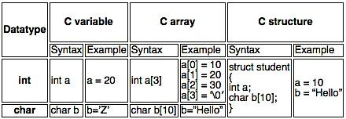
Difference between C variable, array and structure
A normal C variable can hold only one data of one data type at a time.
An array can hold group of data of same data type.
A structure can hold group of data of different data types
Data types can be int, char, float, double and long double etc.

Slide 7
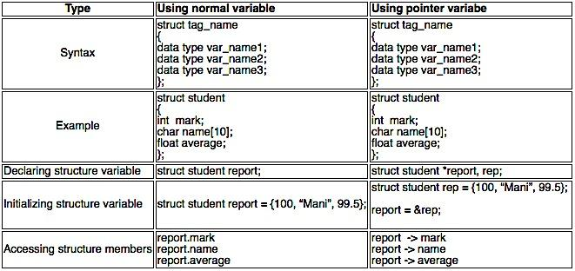
Below table explains following concepts in C structure
How to declare a C structure?
How to initialize a C structure?
How to access the members of a C structure?

Slide 8
Accessing members of a structure
Structure can be accessed in 2 ways. They are,
Using normal structure variable
Using pointer variable
There are two types of operators used for accessing members of a structure.
Member operator(.)
Structure pointer operator(->)
Dot(.) operator is used to access the data using normal structure variable.
Arrow (->) is used to access the data using pointer variable.
We already have learnt how to access structure data using normal variable. So, we are showing here how to access structure data using pointer variable.

Slide 9
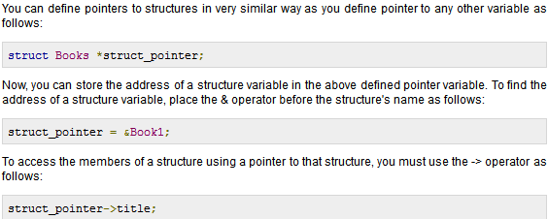
Pointers to Structures

Slide 10
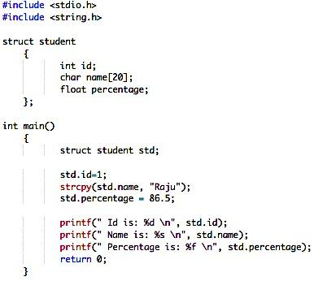
Example program for C structure
This program is used to store and access “id, name and percentage” for one student. We can also store and access these data for many students using array of structures.
Output:
Id is: 1
Name is: Raju
Percentage is: 86.500000

Slide 11
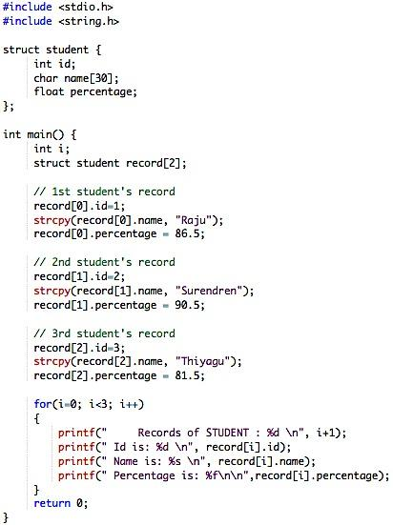
Example program-array of structures
This program is used to store and access “id, name and percentage” for 3 students. Structure array is used in this program to store and display records for many students. You can store “n” number of students record by declaring structure variable as ‘struct student record[n]“, where n can be 1000 or 5000 etc.
Output:
Records of STUDENT : 1
Id is: 1
Name is: Raju
Percentage is: 86.500000
Records of STUDENT : 2
Id is: 2
Name is: Surendren
Percentage is: 90.500000
Records of STUDENT : 3
Id is: 3 Name is: Thiyagu
Percentage is: 81.500000

Slide 12
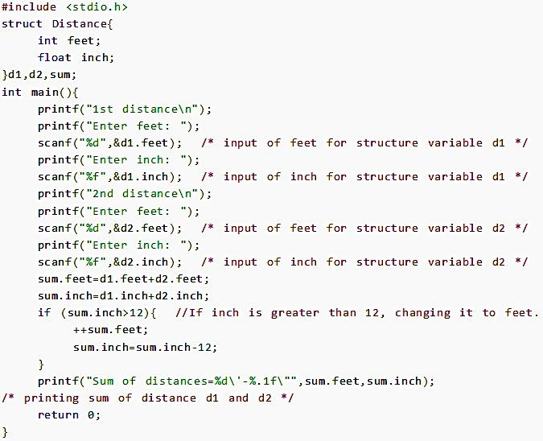
Example program of structure
Write a C program to add two distances entered by user. Measurement of distance should be in inch and feet.(Note: 12 inches = 1 foot)

Slide 13
Passing structure to function
A structure can be passed to any function from main function or from any sub function.
Structure definition will be available within the function only.
It won’t be available to other functions unless it is passed to those functions by value or by address(reference).
Else, we have to declare structure variable as global variable. That means, structure variable should be declared outside the main function. So, this structure will be visible to all the functions in a C program.
Passing structure to function in C: It can be done in below 3 ways.
Passing structure to a function by value
Passing structure to a function by address(reference)
No need to pass a structure – Declare structure variable as global

Slide 14
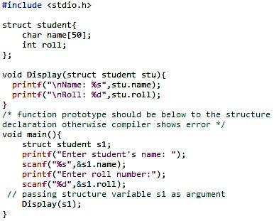
Example – passing structure to function by value
A structure variable can be passed to the function as an argument as normal variable.
If structure is passed by value, change made in structure variable in function definition does not reflect in original structure variable in calling function.
You would access structure variables in the similar way as you have accessed in the above example:
Write a C program to create a structure student, containing name and roll. Ask user the name and roll of a student in main function. Pass this structure to a function and display the information in that function.
Output:
Enter student's name: Kevin
Enter roll number: 149
Name: Kevin
Roll: 149
Passing structure variable

Slide 15
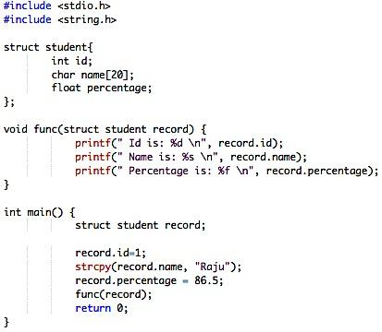
Example – passing structure to function by value
In this program, the whole structure is passed to another function by value. It means the whole structure is passed to another function with all members and their values. So, this structure can be accessed from called function. This concept is very useful while writing very big programs in C.
Output:
Id is: 1
Name is: Raju
Percentage is: 86.500000

Slide 16
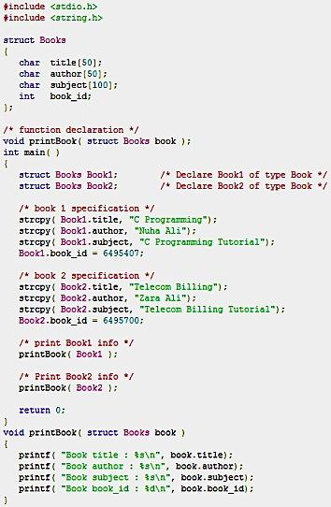
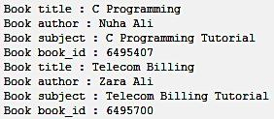
Example – passing structure to function by value

Slide 17
Passing structure to function by address/reference
The address location of structure variable is passed to function while passing it by reference.
If structure is passed by reference, change made in structure variable in function definition reflects in original structure variable in the calling function.
Exercise: Write a C program to add two distances(feet-inch system) entered by user. To solve this program, make a structure. Pass two structure variable (containing distance in feet and inch) to add function by reference and display the result in main function without returning it.

Slide 18
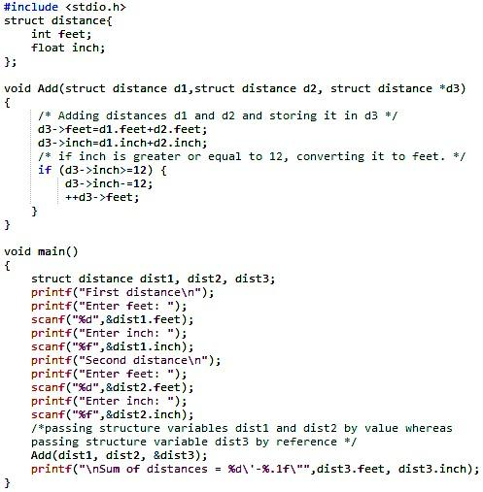
Example–Passing structure to function by reference
Output:
First distance
Enter feet: 12
Enter inch: 6.8
Second distance
Enter feet: 5
Enter inch: 7.5
Sum of distances = 18'-2.3"

Slide 19
Explanation of previous example
In the previous program, structure variables dist1 and dist2 are passed by value (because value of dist1 and dist2 does not need to be displayed in main function) and dist3 is passed by reference ,i.e, address of dist3 (&dist3) is passed as an argument.
Thus, the structure pointer variable d3 points to the address of dist3. If any change is made in d3 variable, effect of it is seed in dist3 variable in main function.

Slide 20
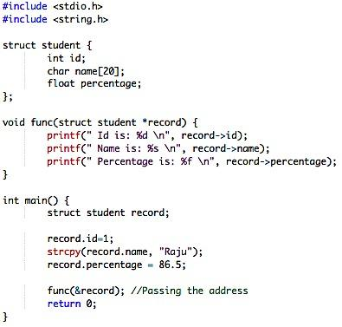
Example–Passing structure to function by address/reference
Here the structure is passed to another function by address. It means only the address of the structure is passed to another function. The whole structure is not passed to another function with all members and their values. So, this structure can be accessed from called function by its address.
Output:
Id is: 1
Name is: Raju
Percentage is: 86.500000

Slide 21
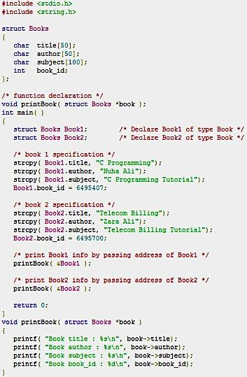
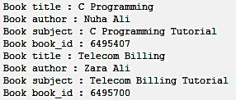
Example–Passing structure to function by address/reference

Slide 22
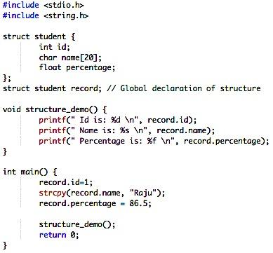
Example program to declare a structure variable as global
Structure variables also can be declared as global variables as we declare other variables in C. So, When a structure variable is declared as global, then it is visible to all the functions in a program. In this scenario, we don’t need to pass the structure to any function separately.
Output:
Id is: 1
Name is: Raju
Percentage is: 86.500000

Slide 23
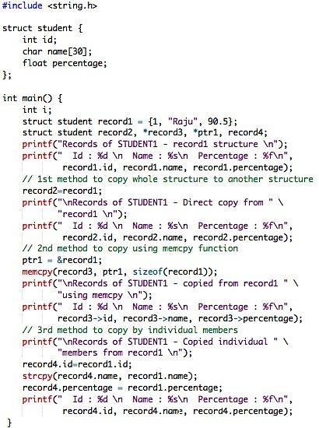
Copy A Structure
There are many methods to copy one structure to another structure in C.
We can copy using direct assignment of one structure to another structure or
we can use C inbuilt function “memcpy()” or
we can copy by individual structure members.
Output:
Records of STUDENT1 - record1 structure Id : 1 Name : Raju Percentage : 90.500000
Records of STUDENT1 – Direct copy from record1 Id : 1 Name : Raju Percentage : 90.500000
Records of STUDENT1 – copied from record1 using memcpy Id : 1 Name : Raju Percentage : 90.500000
Records of STUDENT1 – Copied individual members from record1 Id : 1 Name : Raju Percentage : 90.500000

Slide 24
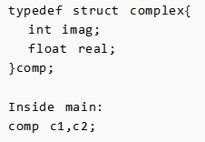
Keyword typedef while using structure
Programmer generally use typedef while using structure in C language. For example:
Here, typedef keyword is used in creating a type comp(which is of type as struct complex). Then, two structure variables c1 and c2 are created by this comp type.

Slide 25
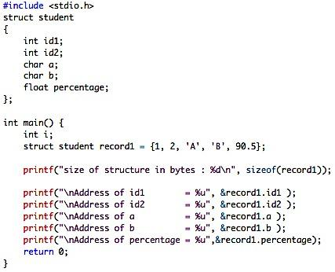
Struct memory allocation
How structure members are stored in memory?
Always, contiguous(adjacent) memory locations are used to store structure members in memory. Consider below example to understand how memory is allocated for structures.
Output:
size of structure in bytes : 16
Address of id1 = 675376768
Address of id2 = 675376772
Address of a = 675376776
Address of b = 675376777
Address of percentage = 675376780

Slide 26
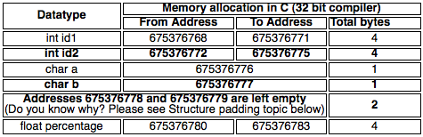
Struct memory allocation
There are 5 members declared for structure in above program. In 32 bit compiler,
4 bytes of memory is occupied by int datatype.
1 byte of memory is occupied by char datatype and
4 bytes of memory is occupied by float datatype.
Please refer below table to know from where to where memory is allocated for each datatype in contiguous (adjacent) location in memory.

Slide 27
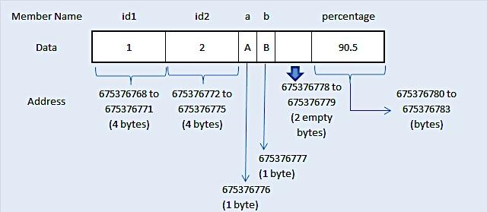
Struct memory allocation
The pictorial representation of above structure memory allocation is given below.
This diagram will help you to understand the memory allocation concept in C very easily.

Slide 28
Structure Padding
In order to align the data in memory, one or more empty bytes (addresses) are inserted (or left empty) between memory addresses which are allocated for other structure members while memory allocation. This concept is called structure padding.
Architecture of a computer processor is such a way that it can read 1 word (4 byte in 32 bit processor) from memory at a time.
To make use of this advantage of processor, data are always aligned as 4 bytes package which leads to insert empty addresses between other member’s address.
Because of this structure padding concept in C, size of the structure is always not same as what we think.

Slide 29
Structure Padding
For example, consider below structure that has 5 members.
struct student
{
int id1;
int id2;
char a;
char b;
float percentage;
};
As per C concepts, int and float datatypes occupy 4 bytes each and char datatype occupies 1 byte for 32 bit processor. So, only 14 bytes (4+4+1+1+4) should be allocated for above structure.
But, this is wrong. Do you know why?
Architecture of a computer processor is such a way that it can read 1 word from memory at a time.
1 word is equal to 4 bytes for 32 bit processor and 8 bytes for 64 bit processor.
So, 32 bit processor always reads 4 bytes at a time and 64 bit processor always reads 8 bytes at a time.
This concept is very useful to increase the processor speed.
To make use of this advantage, memory is arranged as a group of 4 bytes in 32 bit processor and 8 bytes in 64 bit processor.

Slide 30
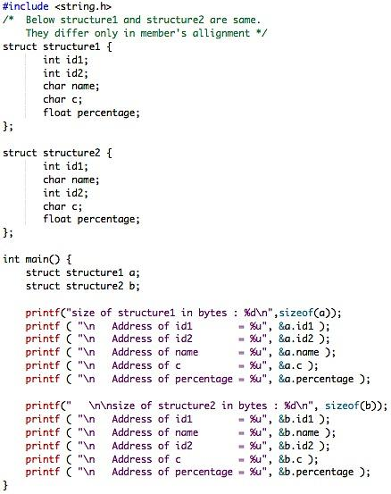
Example program for structure padding
This C program is compiled and executed in 32 bit compiler.
Please check memory allocated for structure1 and structure2 of this program.
Output:
size of structure1 in bytes : 16
Address of id1 = 1297339856
Address of id2 = 1297339860
Address of name = 1297339864
Address of c = 1297339865
Address of percentage = 1297339868
size of structure2 in bytes : 20
Address of id1 = 1297339824
Address of name = 1297339828
Address of id2 = 1297339832
Address of c = 1297339836
Address of percentage = 1297339840

Slide 31
Structure padding analysis for previous C program
Memory allocation for structure1:
In above program, memory for structure1 is allocated sequentially for first 4 members.
Whereas, memory for 5th member “percentage” is not allocated immediate next to the end of member “c”
There are only 2 bytes remaining in the package of 4 bytes after memory allocated to member “c”.
Range of this 4 byte package is from 1297339864 to 1297339867.
Addresses 1297339864 and 1297339865 are used for members “name and c”. Addresses 1297339866 and 1297339867 only is available in this package.
But, member “percentage” is datatype of float and requires 4 bytes. It can’t be stored in the same memory package as it requires 4 bytes. Only 2 bytes are free in that package.
So, next 4 byte of memory package is chosen to store percentage data which is from 1297339868 to 1297339871.
Because of this, memory 1297339866 and 1297339867 are not used by the program and those 2 bytes are left empty.
So, size of structure1 is 16 bytes which is 2 bytes extra than what we think. Because, 2 bytes are left empty.

Slide 32
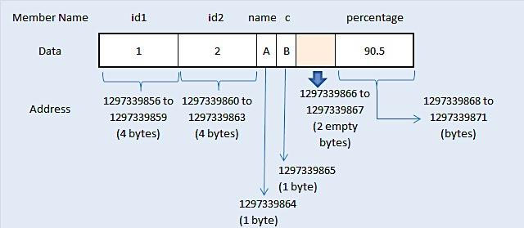
Structure padding analysis for previous C program
Memory allocation for structure1

Slide 33
Structure padding analysis for previous C program
Memory allocation for structure2:
Memory for structure2 is also allocated as same as above concept. Please note that structure1 and structure2 are same. But, they differ only in the order of the members declared inside the structure.
4 bytes of memory is allocated for 1st structure member “id1″ which occupies whole 4 byte of memory package.
Then, 2nd structure member “name” occupies only 1 byte of memory in next 4 byte package and remaining 3 bytes are left empty. Because, 3rd structure member “id2″ of datatype integer requires whole 4 byte of memory in the package. But, this is not possible as only 3 bytes available in the package.
So, next whole 4 byte package is used for structure member “id2″.
Again, 4th structure member “c” occupies only 1 byte of memory in next 4 byte package and remaining 3 bytes are left empty.
Because, 5th structure member “percentage” of datatype float requires whole 4 byte of memory in the package.
But, this is also not possible as only 3 bytes available in the package. So, next whole 4 byte package is used for structure member “percentage”.
So, size of structure2 is 20 bytes which is 6 bytes extra than what we think. Because, 6 bytes are left empty.

Slide 34
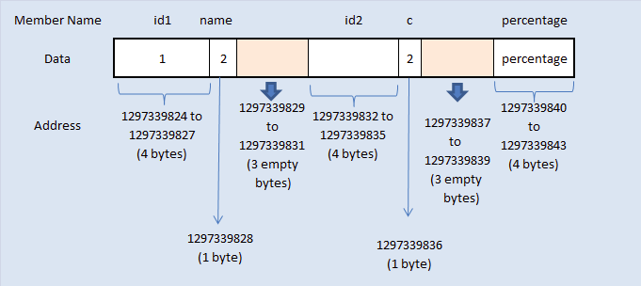
Structure padding analysis for previous C program
Memory allocation for structure2

